Slide 1

Web-application for,
Village Vyapar
“Buy, Sell and Find just about Village Product (c2c)”

Slide 2
INDEX
No. | Content | Slide No.
1 | Group Information | 3
 | Company Profile | 4
3 | Project Definition | 5
4 | System Development Platform | 6
5 | Admin Panel | 7
6 | Customer Panel | 72
7 | Reports | 114
8 | References | 129

Slide 3
1 | Group Information | 3
 | Company Profile | 4
3 | Project Definition | 5
4 | System Development Platform | 6
5 | Admin Panel | 7
6 | Customer Panel | 72
7 | Reports | 114
8 | References | 129

Slide 4
Group Information :
GROUP NO : 04
Full Name | Enrollment No
Raja Himani Yatin | 205160694004
Chauhan Zeel Jitendrakumar | 205160694009
Parmar Devansh Rajeshbhai | 205160694023
Lashkari Parth Ashokbhai | 205160694029
Internal Faculty : :
Prof. Alka Patel

Slide 5
1
INTRODUCTION

Slide 6

Existing System :
Existing system is trading between people through calls,
and middle man therefore it is limited geographically.

Slide 7


Need for the New System :
The geographical limitation stops the business from growing and hence a lot of products do not get much attention.
It is difficult to account for the sales.
Cost of product is increased as middle man is included also
there is thin profit margin

Slide 8
Objective of New System :
This system allows to directly communicate via chat board so customer and
seller can negotiate on suitable price.
To increase the sales of the current small scale village businesses.
To provide multiple source of the same products which ensures that the
customer gets the desired quality product.
Cost of product is reduced as middle man is eliminated.
Customer can view products in any native language.

Slide 9
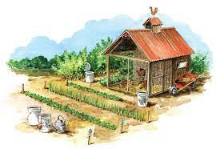
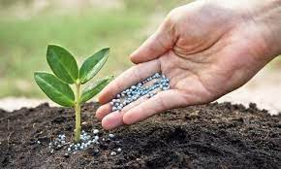
Project Definition :
This project is aimed at developing a web application that depicts online shopping of village products such as
food, Animals feed, Handicraft etc.
This web application also allows customer to
sell the product and others can purchase or vice versa
(i.e. Customer to Customer).
It provides a communication medium via chat board.

Slide 10




Core Components :
Admin
Customer
Visitor

Slide 11
Admin
Login
Manage Profile
Manage Customers
Manage Category & Sub category
Manage Products
Manage Inquiry
Manage Feedback
Generate Reports

Slide 12
Customer
Login
Manage Profile
Search Rural Product
View Categories & Sub Categories
View Rural Product in multiple language
Chat with Seller/Buyer
Inquiry
Feedback
Manage Inquiry
Manage Product
Manage Wishlist

Slide 13
Visitor
Registration
Search Rural Product
View Rural Product
View Feedback & Rating

Slide 14
Project Profile :

Slide 15
Assumptions & Constraint :

Slide 16
Advantages of Proposed System :

Slide 17
Disadvantage of Proposed System :

Slide 18
2
Requirement Determination & Analysis

Slide 19

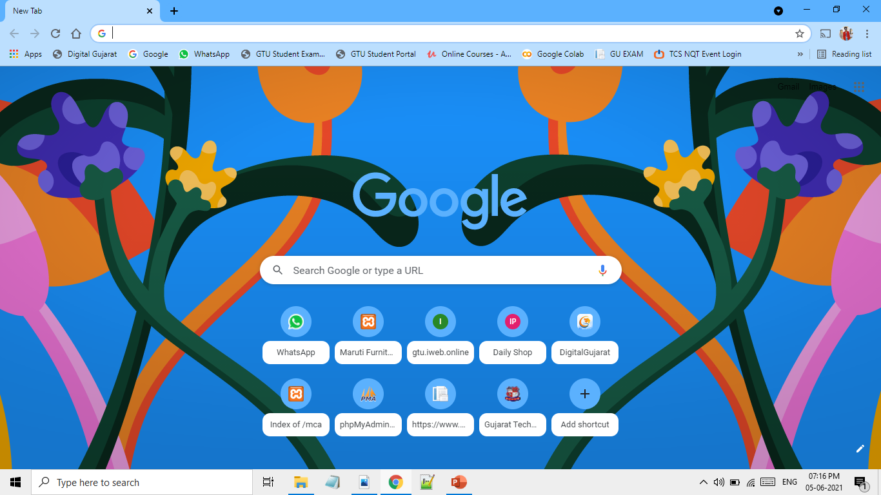
Requirement Determination

Slide 20
Targeted Users

Slide 21
3
System Design

Slide 22
Use Case Diagram

Slide 23
Class Diagram

Slide 24
Interaction Diagram

Slide 25
Activity Diagram

Slide 26
Data Dictionary

Slide 27
4
Development

Slide 28
5
Proposed Enhancement

Slide 29
6
Conclusion

Slide 30
7
Bibliography

Slide 31
CONTENTS
1
4
ADD THE SLIDE TITLE HERE
ADD THE SLIDE TITLE HERE
Please add a comment here
Please add a comment here
2
5
ADD THE SLIDE TITLE HERE
ADD THE SLIDE TITLE HERE
Please add a comment here
Please add a comment here
3
6
ADD THE SLIDE TITLE HERE
ADD THE SLIDE TITLE HERE
Please add a comment here
Please add a comment here

Slide 32
1
ADD THE SLIDE TITLE HERE
PLEASE ADD SLIDE SUBTITLE HERE

Slide 33



Please add title in here
ADD
KEY
WORDS
Please add text here, according to the need to adjust the font and font size. Please add text here, according to the need to adjust the font and font size.
Please add text here, according to the need to adjust the font and font size. Please add text here, according to the need to adjust the font and font size.
Please add text here, according to the need to adjust the font and font size.
ADD
KEY
WORDS
ADD
KEY
WORDS
Please add title in here
Please add text here, according to the need to adjust the font and font size.

Slide 34
Please add title in here
Please add text here, according to the need to adjust the font and font size. Please add text here.
Please add text here, according to the need to adjust the font and font size. Please add text here, according to the need to adjust the font and font size.
1 ADD KEY WORDS
Please add text here, according to the need to adjust the font and font size. Please add text here.
2 ADD KEY WORDS
Please add text here, according to the need to adjust the font and font size. Please add text here.
3 ADD KEY WORDS
Please add text here, according to the need to adjust the font and font size. Please add text here.
4 ADD KEY WORDS
Please add text here, according to the need to adjust the font and font size. Please add text here.
5 ADD KEY WORDS

Slide 35

Please add title in here
Please add text here, according to the need to adjust the font and font size. Please add text here, according to the need to adjust the font and font size.
Please add text here, according to the need to adjust the font and font size. Please add text here, according to the need to adjust the font and font size.
Please add title in here
Please add text here, according to the need to adjust the font and font size. Please add text here.

Slide 36
Please add text here, according to the need to adjust the font and font size, recommended justified form.
64%
50%
75%
ADD KEY WORDS
ADD KEY WORDS
ADD KEY WORDS
Please add text here, according to the need to adjust the font and font size.
Please add text here, according to the need to adjust the font and font size.
Please add text here, according to the need to adjust the font and font size.

Slide 37
ADD KEY WORDS
ADD KEY WORDS
Please add text here, according to the need to adjust the font and font size. Please add text here, according to the need to adjust the font and font size.
Please add text here, according to the need to adjust the font and font size. Please add text here, according to the need to adjust the font and font size.
Please add text here, according to the need to adjust the font and font size. Please add text here, according to the need to adjust the font and font size.
ADD KEY WORDS
Please add text here, according to the need to adjust the font and font size, recommended justified form. Please add text here, according to the need to adjust the font and font size.

Slide 38
10
Please add text here, according to the need to adjust the font and font size.
09
08
07
06
05
04
03
02
01
01
02
03
04
05
06
07
08
09
10
11
12
Please add text here, according to the need to adjust the font and font size, recommended justified form.

Slide 39
ADD KEY WORDS
ADD KEY WORDS
ADD KEY WORDS
Please add text here, according to the need to adjust the font and font size. Please add text here, according to the need to adjust the font and font size.
Please add text here, according to the need to adjust the font and font size. Please add text here, according to the need to adjust the font and font size.
Please add text here, according to the need to adjust the font and font size. Please add text here, according to the need to adjust the font and font size.
Please add text here, according to the need to adjust the font and font size. Please add text here, according to the need to adjust the font and font size.

Slide 40


Please add text here, according to the need to adjust the font and font size. Please add text here, according to the need to adjust the font and font size.
Please add text here, according to the need to adjust the font and font size. Please add text here, according to the need to adjust the font and font size.
Please add text here, according to the need to adjust the font and font size. Please add text here, according to the need to adjust the font and font size. Please add text here, according to the need to adjust the font and font size. Please add text here, according to the need to adjust the font and font size.

Slide 41
Please add title in here
Please add text here, according to the need to adjust the font and font size.
000T
000T
000T
000T
000T
000T
000T
000T
000T
000T
000T
000T
01
02
03
04
05
06
07
08
09
10
11
12
Please add text here, according to the need to adjust the font and font size. Please add text here, according to the need to adjust the font and font size.

Slide 42
Please add text here, according to the need to adjust the font and font size.
Please add text here, according to the need to adjust the font and font size.
ADD KEY WORDS
ADD KEY WORDS
ADD KEY WORDS
ADD KEY WORDS
Please add text here, according to the need to adjust the font and font size.
Please add text here, according to the need to adjust the font and font size.
Please add text here, according to the need to adjust the font and font size. Please add text here, according to the need to adjust the font and font size. Please add text here, according to the need to adjust the font and font size. Please add text here.

Slide 43
3
ADD THE SLIDE TITLE HERE
PLEASE ADD SLIDE SUBTITLE HERE

Slide 44
Please add text here, according to the need to adjust the font and font size.
ADD KEY WORDS
Please add text here, according to the need to adjust the font and font size. Please add text here, according to the need to adjust the font and font size.
Please add text here, according to the need to adjust the font and font size. Please add text here, according to the need to adjust the font and font size.
ADD
KEY WORDS
ADD KEY WORDS
ADD KEY WORDS
ADD KEY WORDS
Please add text here, according to the need to adjust the font and font size.
Please add text here, according to the need to adjust the font and font size. Please add text here, according to the need to adjust the font and font size. Please add text here, according to the need to adjust the font and font size.

Slide 45



Please add text here, according to the need to adjust the font and font size. Please add text here, according to the need to adjust the font and font size.
5 ADD KEY WORDS
5 ADD KEY WORDS
5 ADD KEY WORDS
Please add text here, according to the need to adjust the font and font size. Please add text here, according to the need to adjust the font and font size.
Please add text here, according to the need to adjust the font and font size. Please add text here, according to the need to adjust the font and font size.
Please add text here, according to the need to adjust the font and font size. Please add text here, according to the need to adjust the font and font size.

Slide 46
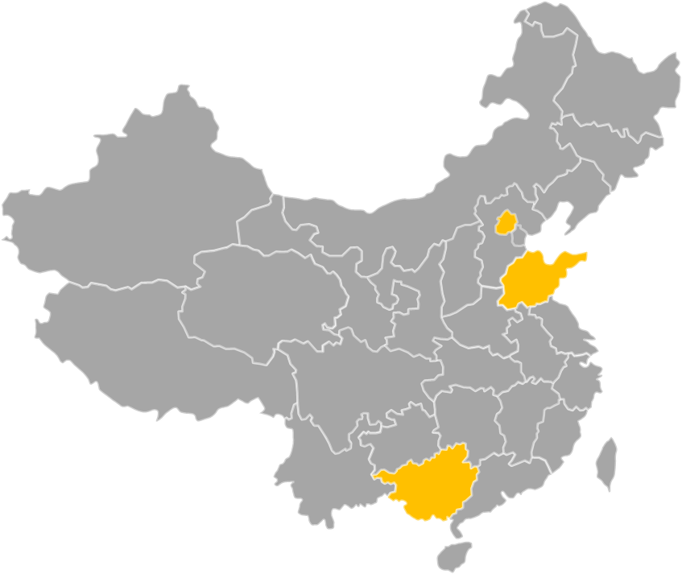
Please add title in here
Please add title in here
Please add text here, according to the need to adjust the font and font size.
Please add title in here
Please add text here, according to the need to adjust the font and font size.
Please add title in here
Please add text here, according to the need to adjust the font and font size.

Slide 47
Please add text here, according to the need to adjust the font and font size. Please add text here, according to the need to adjust the font and font size.
Please add text here, according to the need to adjust the font and font size. Please add text here, according to the need to adjust the font and font size.
Please add text here, according to the need to adjust the font and font size. Please add text here, according to the need to adjust the font and font size.
ADD KEY WORDS
ADD KEY WORDS
ADD KEY WORDS
Please add text here, according to the need to adjust the font and font size. Please add text here, according to the need to adjust the font and font size.

Slide 48
Please add title in here
Please add title in here
Please add text here, according to the need to adjust the font and font size. Please add text here, according to the need to adjust the font and font size.
Please add text here, according to the need to adjust the font and font size. Please add text here, according to the need to adjust the font and font size.
Please add text here, according to the need to adjust the font and font size. Please add text here, according to the need to adjust the font and font size.
Please add text here, according to the need to adjust the font and font size. Please add text here, according to the need to adjust the font and font size.
Please add text here, according to the need to adjust the font and font size. Please add text here, according to the need to adjust the font and font size. Please add text here, according to the need to adjust the font and font size.

Slide 49
THANK YOU
Group No : 04

